Slide 1



Peer mentor sessions
View in Power BI
Last data refresh:
3/3/2022 12:32:58 AM UTC
Downloaded at:
3/17/2022 3:23:58 AM UTC

Slide 2
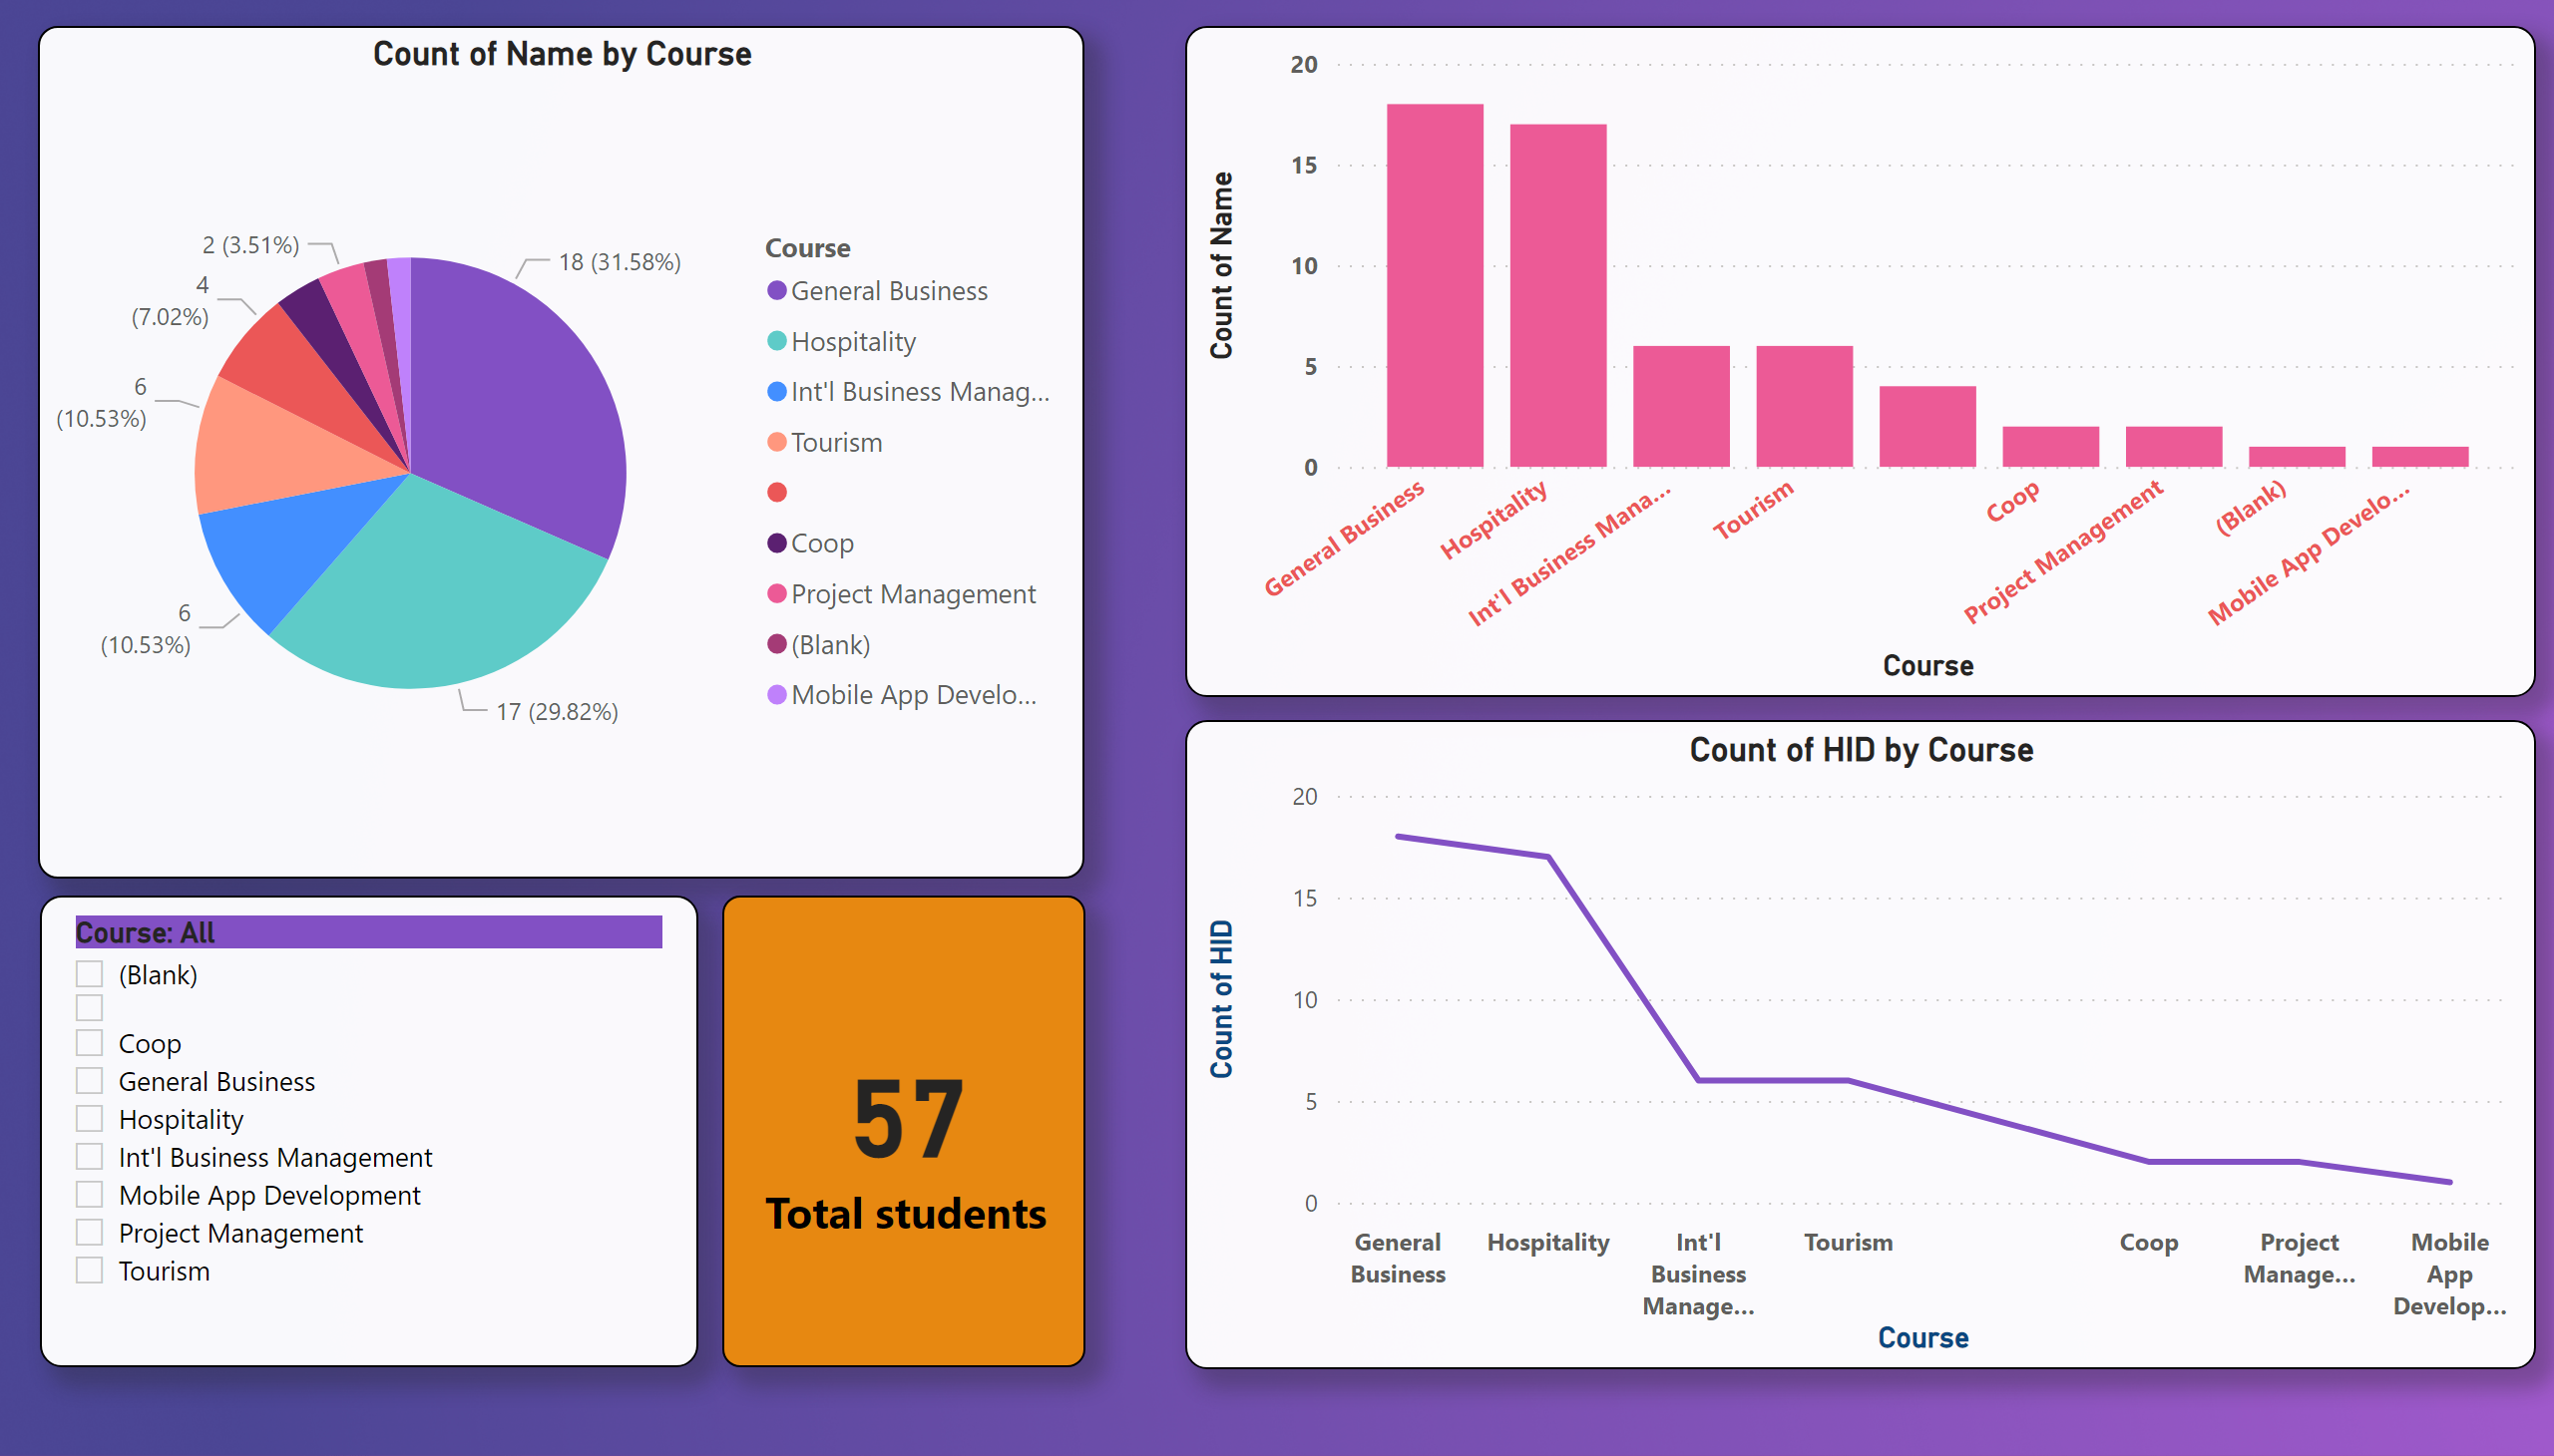
Page 1
Notes:
slicer
No alt text provided
card
No alt text provided
lineChart
No alt text provided
lineStackedColumnComboChart
No alt text provided
pieChart
No alt text provided

